Slide 1
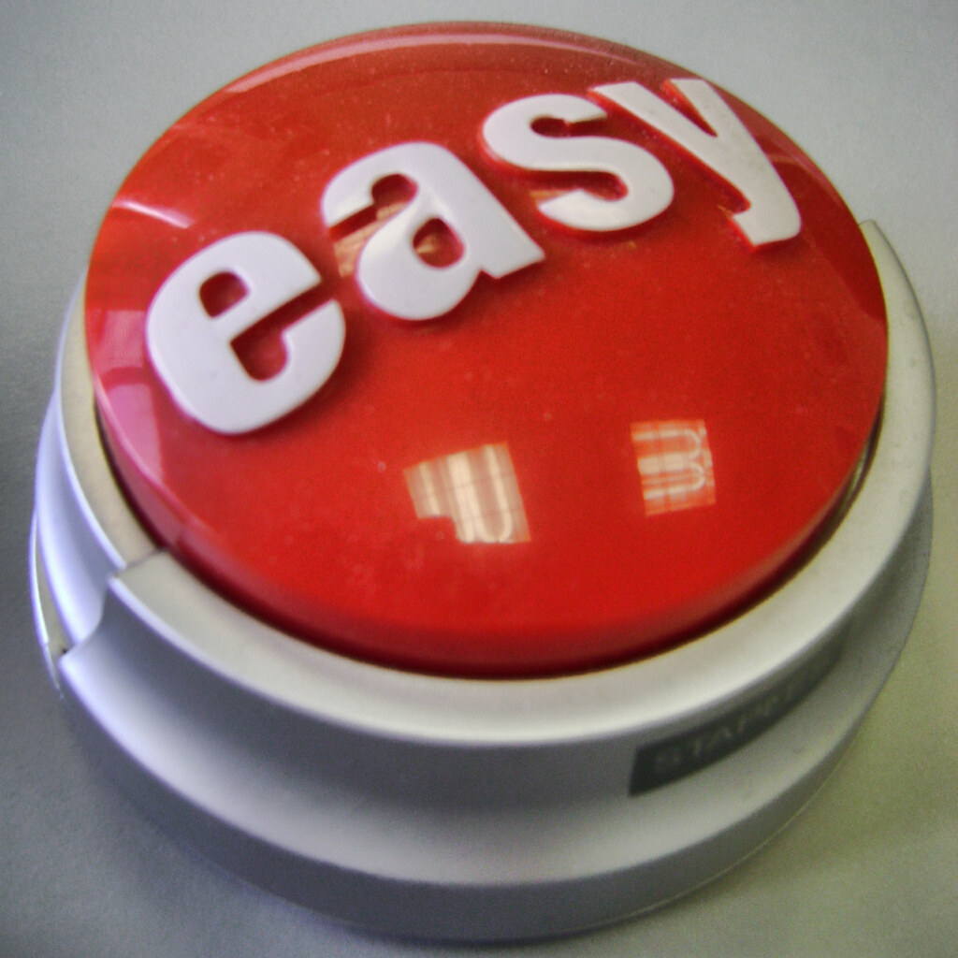
JA COUNTER COUNTER COLLEGE FMLA ADMINISTRATION
Goal: Inspire You to Think Differently
Foundation for Successful FMLA Administration:
Develop Clear Paradigm for How to Effectively Analyze Leave Scenarios
July 13, 2021
Bryan Symes – Shareholder, von Briesen & Roper
bsymes@vonbriesen.com
“SNAKE OIL FOR SALE”
The information contained in this video, which is based upon federal and Wisconsin law as of July 13, 2021, is provided to inform and not to advise. No person should ever apply or interpret any law without the aid of a trained expert who knows the facts, because the facts may change the application of the law. The information provided in the video is not, and shall not be construed as, legal advice.

Slide 2
“FMLA” Stands For…
Layers of Complexity
Topics of Discussion for Today:
Looked back at FMLA questions I have fielded over past two years.
Asked trusted, seasoned HR professionals with whom I regularly work [issues].
Picked handful of the “most common” concepts to address.
Hopefully make less “maddening”
Frustrating
Maddening
Laborious
Absurd
“Fridays and Mondays Leave Act”

Slide 3
Majesco’s FMLA Knowledge Gap 2020: Employee and Manager Insights – Published February 2021
More than 1,000 respondents
Respondents worked for businesses with 100 to 10,000+ employees
Managers = 43% of respondents; Rank-and-File = 57% of respondents
Survey asked three questions:
According to the FMLA, what type of employer is required to offer FML?
What benefit does the FMLA provide?
How long can an employee be absent under the FMLA regulations?
To be “knowledgeable” = had to correctly answer all three questions
Only 11% of Managers and 13% of Rank-and-File Received “Knowledgeable” Score
One Observation and One Action Item:
Your Jobs Are HARD!!!
Train, Train, and Train Managers
VALIDATION

Slide 4
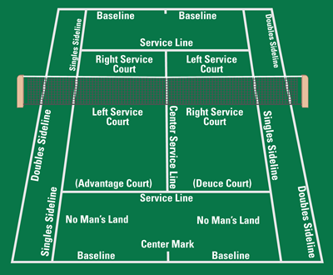
When is an Employer on Notice of Need for FMLA Leave?
FMLA Has Its Own No Man’s Land:
That Place Where We Struggle to Know Whether Circumstances Represent Sufficient Notice of the Need for FMLA leave
Place Where Mistakes Happen!!!

Slide 5
FMLA – Notice of Leave in No-Man’s Land?
No-Man’s Land – Hard to Identify When Leave is Needed When Employee Does Not Ask for it Specifically
Basic Employee Notice Standards – Quick Refresher
Employee need not expressly assert rights under the FMLA or even mention FMLA. 29 C.F.R. §825.302(c).
Calling in “sick,” without more, clearly is NOT sufficient notice to trigger employer’s obligations under FMLA. 29 C.F.R. §825.303(b).
NO-MAN’S LAND CREATES UNCERTAINTY:
WHEN IS NOTICE TRULY “SUFFICIENT”?

Slide 6
FMLA – Notice of Leave in No-Man’s Land?
“Sufficient” Notice Triggers Employer Duty Under the FMLA to Investigate:
Proof = “In all cases, the employer should inquire further of the employee if it is necessary to have more information about whether FMLA leave is being sought by the employee, and obtain the necessary details of the leave to be taken.” 29 C.F.R. § 825.302(c)(foreseeable need for leave).
More Proof = “The employer will be expected to obtain any additional required information through informal means.” 29 C.F.R. § 825.303(c)(unforeseeable need for leave).
Failure to inquire = FMLA Interference and/or FMLA Retaliation ($$$).
THAT’S A LOT OF PRESSURE TO CORRECTLY
EVALUATE WHETHER NOTICE IS“SUFFICIENT”!!!

Slide 7
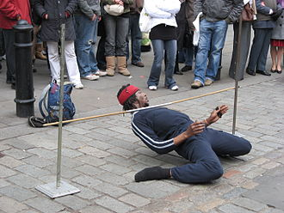
FMLA –Notice of Leave in No-Man’s Land?
Basic Employee Notice Standards – What is Sufficient Notice – Quick Refresher
Employee must provide sufficient notice:
That the employee “…likely has an FMLA-qualifying condition.”
That provides “…enough information to establish probable cause to believe the employee is entitled to FMLA leave.”
“Probable” means a “reasonable ground for belief.”

Slide 8
FMLA – Notice of Leave in No-Man’s Land?
Strategic recommendations:
Constructive notice [no request; pattern of behavior](stray puppy case):
Stray puppy climbed through windows of manufacturing facility [not menacing]
Employee with no history of health problems began: (1) spraying glade room deodorizer everywhere; (2) yelling and cursing [“f@#king animals shouldn’t be in the workplace”]; (3) said was ill and had to go home.
Two days later, yelled at supervisor, “wrong to be subjected to f@#king dogs running by her desk and threatening her.”
Filed complaint with OSHA.
Employer terminated for absences and conduct, without considering FMLA.
Extreme Example? Perhaps.
What about Uncontrollable Crying at Work?
Other Situations?

Slide 9
FMLA – Notice of Leave in No-Man’s Land?
Strategic recommendations:
Ignorance is not bliss—solicit additional information whenever there is uncertainty about whether the FMLA is implicated. Employer is duty bound to investigate [remember the stray puppy case]. Paradigm = Analyze through employee-friendly lens!!!
Default position should be to provide FMLA paperwork to employee [especially notice of eligibility and certification; WH-380 and WH-381]. When in doubt, send it out. In my opinion, “best practices” approach.
“Think outside the box” [employers get tripped up - “psychological care” during “bucket list” trip to Vegas].
Cliché Alert

Slide 10
TEST YOUR KNOWLEDGE – SUFFICIENT NOTICE?
Employee provides note from his doctor, confirming that he is “ill” and has been “seen by a doctor.”
Employee reports having a “twisted knee.”
Employee asks for 30 days to “take care of things” following the death of her spouse.
All of the above.
None of the above.

Slide 11
TEST YOUR KNOWLEDGE – SUFFICIENT NOTICE?
Employee repeatedly calls in sick.
Employee notifies her supervisor of her need for “throat surgery.”
Employee complains of suffering from “stress” and “anxiety.”
All of the above.
None of the above.
LESSON – THINK DIFFERENTLY:
Do Not Assume That Your Initial Conclusion Is Bulletproof
Very Subjective Analysis – Use “Team” Approach

Slide 12
QUESTIONS?

Slide 13
How to Properly Respond to Telecommuter Requests for FMLA?
Enterprise Technology Research
16.4% Permanently Remote Pre-Pandemic
34.4% Permanently Remote in 2021

Slide 14
FMLA – Telecommuters
Why do we care?
Again, the concern here is possible FMLA Interference and/or FMLA Retaliation.
Eligible employee under the FMLA must be [29 C.F.R. § 825.110(a)(3)]:
Employed at a worksite, where 50 or more employees are employed within a 75-mile radius of that worksite [concept - draw a circle around your employee].
The concept of “worksite” under the FMLA is VERY important in this context!

Slide 15
FMLA – Telecommuters
Definition of Worksite?
Regulations indicate [29 C.F.R. § 825.111(a)(2)]:
“Personal residence” is not a worksite for “employees who work at home, as under the concept of…telecommuting.”
“Rather, their worksite is the office to which they report OR from which assignments are made.”

Slide 16
FMLA – Telecommuters – Other Considerations
Avoid creating chilling effect? 29 C.F.R. § 311(a)
May be tempted to apply increased scrutiny due to remote work.
Terwilliger v. Howard Memorial Hospital case – the “Chill Theory”:
During leave, direct supervisor made weekly calls to ask when employee was going to return to work. Also emphasized importance of returning as soon as possible.
Interference occurs “when an employer’s action deters an employee’s exercise of FMLA rights.”
Employees have a right “not to be discouraged” from taking FMLA leave.
Utilize HR to make contact instead of direct supervisor (“chill” concern).

Slide 17
QUESTIONS?

Slide 18
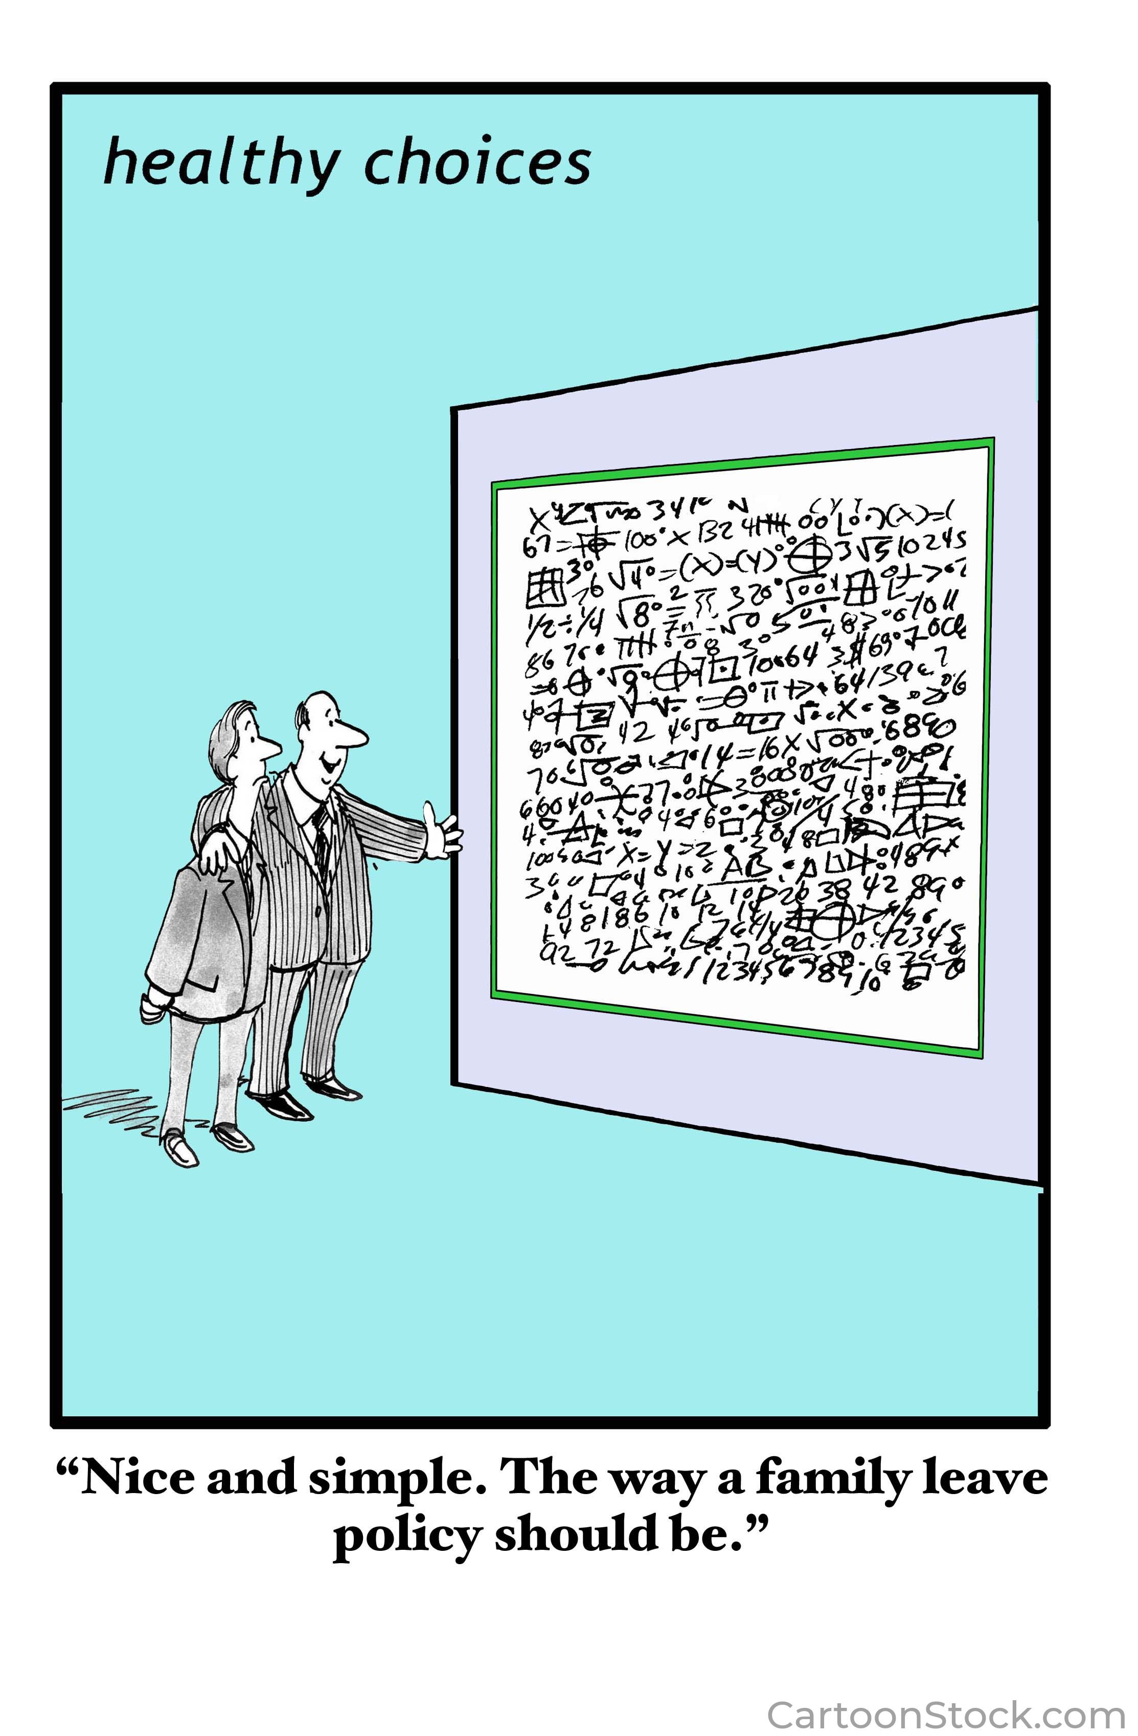
How to Properly Police Employer’s Customary Notice and Procedural Requirements?
Observations:
Many Handbooks Fail to Direct Employees re How Specifically to Request Leave.
Many FMLA Policies Do, But Are Lawsuits Waiting to Happen [Unlawful Language]!!!

Slide 19
Policing Usual and Customary Procedures
Written FMLA leave request procedures are beneficial:
Staff management/planning [customary call-in procedures]; and
Curbing FMLA abuse – established procedures are more difficult to manipulate – adds accountability [may delay or deny leave if policies not followed].
Employees must follow the employer’s “usual and customary” notice/call-in and procedural requirements for requesting FMLA leave, absent “unusual circumstances.”

Slide 20
Policing Usual and Customary Procedures
“Unusual circumstances” – think “emergency” or “unexpected” situation
Unexpected hospitalization [admitted to a psychiatric facility].
Employee is involved in car accident.
Medical emergency [bipolar medications cause employee to oversleep].
Natural disaster.

Slide 21
Policing Usual and Customary Procedures
Regulations - Timing and Default Content for Requesting Leave - Foreseeable
At least 30 days advance notice before FMLA leave is to begin.
If 30 days is not practicable [e.g., because of a lack of knowledge of approximately when leave will be required to begin, a change in circumstances], notice must be given as soon as practicable [same day employee becomes aware of need for leave, or next business day].
At least verbal notice (circumstances, anticipated timing, anticipated duration).

Slide 22
Policing Usual and Customary Procedures
Regulations - Timing and Default Content for Requesting Leave - Unforeseeable
Employee must provide notice to the employer as soon as practicable under the facts and circumstances of the particular case.
DOL instructs: Generally should be practicable within the time prescribed by the employer’s usual and customary notice requirements applicable to such leave.
Verbal (circumstances); spokesperson may provide notice (e.g., spouse, adult family member).

Slide 23
Policing Usual and Customary Procedures
If Employer Has Policy – Absent Unusual Circumstances (revert to default timing/content):
Administrative Ease and Accountability
Foreseeable
Written request;
Tracks regulatory timing requirements;
Reasons for leave;
Anticipated start date, anticipated duration;
Contact specific individual(s).
Unforeseeable
Contact specific individual(s);
Call a designated telephone number;
Tracks regulatory timing requirements.

Slide 24
Foreseeable vs Unforeseeable – How It Impacts Enforcement
Gienapp v. Harbor Crest (7th Cir.)
In January, Employee told management she needed time off to care for daughter with cancer, and FMLA leave was granted.
While on leave, employee returned company’s FMLA form, leaving blank the question about anticipated duration of FMLA leave.
In January, doctor issued statement—daughter would need assistance following her recovery from treatment at least through July, but employee’s 12 weeks of FMLA leave would be exhausted at the end of March.

Slide 25
Foreseeable vs Unforeseeable – Policy Enforcement
Gienapp v. Harbor Crest (7th Cir.)
Company hired replacement in February, while employee was on leave [HR assumed employee would not return after exhausting 12-week allotment, due to daughter’s estimated recovery time].
Employee reported to work on March 29—was told no longer had a job.
Company claimed employee failed to provide “essential” information—claimed the FMLA leave was “foreseeable,” and employee did not confirm anticipated duration [could deny leave]. Court = “unforeseeable;” employee did not have to provide anticipated duration as called for by company’s procedures.

Slide 26
Foreseeable vs Unforeseeable – Policy Enforcement
Gienapp v. Harbor Crest (7th Cir.) – Lessons
Leave is foreseeable until it is not—the FMLA anticipates “unexpected” circumstances [so be prepared to be flexible and vigilant]. In this case, employer confused “foreseeable” and “unforeseeable,” and paid the price.
If an employee cannot provide an expected return to work date for unforeseeable leave, an employer should wait until the employee’s twelve weeks of FMLA leave expires before considering whether to replace the employee.
Employers should include language in their FMLA policy requiring employees to provide written periodic updates regarding their expected duration of leave if the leave is unforeseeable and they cannot specify a return to work date on the FMLA application.

Slide 27
Policing Usual and Customary Procedures
Common Reasonable and Unreasonable Components
Call two phone numbers regarding unforeseeable need for leave (“dual notice” – generally reasonable).
Provide notice directly to his or her supervisor in connection with unforeseeable need for leave (Unreasonable - regulations condone indirect notice, through spokesperson, in connection with unforeseeable need for leave).

Slide 28
QUESTIONS?

Slide 29
How to Properly Handle Bonuses For Employees on FMLA Leave?

Slide 30
FMLA – Bonuses
Why do we care?
Employee who returns to work following FMLA leave must be returned to “…equivalent…pay,” status which includes “any bonus….” 29 C.F.R. § 825.215(c)(2). This means we need to evaluate to avoid possible FMLA violations.
Unequal treatment of those on FMLA-protected leave could give rise to FMLA interference and retaliation claims.
Under pertinent law a bonus is considered a “wage.”

Slide 31
FMLA – Bonuses
Two Types of Bonuses for FMLA Purposes – Treated Differently:
Unconditional. Not premised on the achievement of a specified goal [e.g., not awarded based on hours worked, products sold, perfect attendance; safety record]; awarded to all employees, regardless of individual production [e.g., a holiday bonus].
Employee is entitled to unconditional bonus that occurred during the FMLA leave period.

Slide 32
FMLA – Bonuses
Two Types of Bonuses for FMLA Purposes – Treated Differently:
Conditional. Bonus tied to achievement of specified goals [e.g., hours worked; products sold; perfect attendance; employee safety].
Employee is entitled to conditional bonus in accordance with the employer’s policy or practice with respect to other employee’s on an equivalent leave status for a reason that does not qualify as FMLA leave [may deny unless provide to those on “equivalent” non-FMLA]. Huh, what does this mouthful mean?
In other words, cannot treat employees on equivalent non-FMLA leave more favorably [e.g., paid vacation v. paid FMLA; unpaid leave v. unpaid FMLA].

Slide 33
FMLA – Bonuses
Miscellaneous:
Employers may prorate conditional bonuses when employees do not achieve the goal [e.g., hours worked] due to FMLA leave, provided they do so in a non-discriminatory manner. 73 Fed. Reg. at 67985.
Generally, bonuses that are tied to corporate performance/profitability (not individual performance) should be treated as unconditional bonuses for FMLA purposes. Caldwell v. Building Plastics, Inc. (2009).

Slide 34
QUESTIONS?

Slide 35
How to Properly Handle Incomplete and/or Insufficient Certification Forms?

Slide 36
FMLA – Incomplete/Insufficient Certification Forms
General Requirement. Employee must provide a “complete and sufficient medical certification.”
Incomplete or Insufficient Certification.
Incomplete = Form in which one of the applicable entries has not been completed.
Insufficient = Form that is complete, but in which one of the entries is vague, ambiguous, or non-responsive.

Slide 37
FMLA – Incomplete/Insufficient Certification Forms
Hansler v. Lehigh Valley Hospital – Case Study to Illustrate Important Point About Analyzing Whether Certification Form is “Insufficient”
Employee submitted certification form that failed to unambiguously address the nature and duration of her condition—it read, “…probable duration of one month.” Nature [medical facts—e.g., symptoms, diagnosis, hospitalization, etc.] and duration is required for a “sufficient” certification. 29 C.F.R. § 825.306.
Several weeks later, employer terminated employee’s employment based upon absenteeism, and claimed that FMLA request was denied, because request procedures not followed. Employer’s position: “one month” = duration of condition, so not “extended period of time,” so not “serious health condition,” so not entitled to FMLA leave.

Slide 38
FMLA – Incomplete/Insufficient Certification Forms
Hansler v. Lehigh Valley Hospital – Not So Fast!!!
Court concluded that medical certification was vague—does “one month” refer to amount of leave needed or duration of condition? So, “insufficient.”
Court concluded Employer was obligated to provide notice of deficiencies and seven calendar-day cure period. 29 C.F.R. § 825.305.

Slide 39
FMLA – Incomplete/Insufficient Certification Forms
Lessons: Hansler v. Lehigh Valley Hospital
The employer shall advise an employee whenever the employer finds a certification incomplete or insufficient, and shall state in writing what additional information is necessary to make the certification complete and sufficient. 29 C.F.R. § 825.305.
Must give employee benefit of the doubt if certification is arguably ambiguous. Employer’s determination is not outcome determinative.
Always ask yourself, is there an employee-friendly interpretation of the certification form that supports “incompleteness” or “insufficiency”? If so, provide written notice and opportunity to cure

Slide 40
FMLA – Incomplete/Insufficient Certification Forms
What if notice and opportunity to cure and certification remains insufficient?
Authentication of Certifications. Only after notice/cure - confirming opining healthcare provider actually completed the certification form. 29 C.F.R. § 825.307. PERMISSIVE/NOT REQUIRED
Clarification of Certifications. Only after notice/cure – understand opining healthcare provider’s handwriting or the meaning of a particular response. 29 C.F.R. § 825.307. PERMISSIVE/NOT REQUIRED
Doctors, podiatrists, dentists, clinical psychologists, optometrists, chiropractors, nurse practitioners, clinical social workers, physician assistants, etc.

Slide 41
FMLA – Incomplete/Insufficient Certification Forms
Contact with Healthcare Provider
Authentication = NO employee consent required.
Clarification = employee consent required, preferably in writing [or ask employee to do it].
Point Person = Employer must use healthcare provider, human resources professional, a leave administrator, or a management official to contact opining physician. However, may not use employee’s direct supervisor.

Slide 42
QUESTIONS?

Slide 43
How to Handle Two Esoteric FFCRA Considerations?

Slide 44
FFCRA – Does EFML Count Against Classic FMLA
No Guidance – So “Risk Tolerance” Analysis
Conservative Approach = treat as two separate buckets of leave [12 weeks “classic” FMLA and 12 weeks “emergency FML”]. Uncommon approach.
Higher Risk Tolerance Approach = EFML counts toward the12 week maximum under “classic” FMLA.

Slide 45
Employer Does Not Voluntarily Extend FFCRA – Is an Asymptomatic COVID-19 Positive Employee Eligible for Classic FMLA?
Sequence of events:
Employee tests positive for COVID-19.
Completely asymptomatic, so no doctor visit and no regimen of continuing treatment.
Employee is advised by physician to quarantine for 14 days.
Employee’s position is not one that can be performed remotely.

Slide 46
Employer Does Not Voluntarily Extend FFCRA – Is an Asymptomatic COVID-19 Positive Employee Eligible for Classic FMLA?
Moral of the Story – this constitutes a potential need for FMLA leave, so request medical certification instead of taking an adverse employment action [court applied notice and opportunity to cure analysis applicable to medical certifications].

Slide 47
Attendee Questions

Slide 48
Thank You
Bryan T. Symes bsymes@vonbriesen.com 715-214-1800

